Slide 1
Chapter 1
You: Working with Young Children

Slide 2
Question
What qualities do you believe a teacher working with young children should possess?
Discuss with your table and list the qualities on chart paper.
Fill out “Is Teaching for You?” questionnaire honestly.

Slide 3
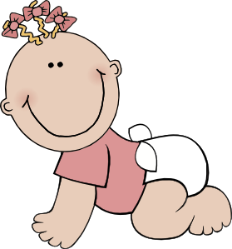
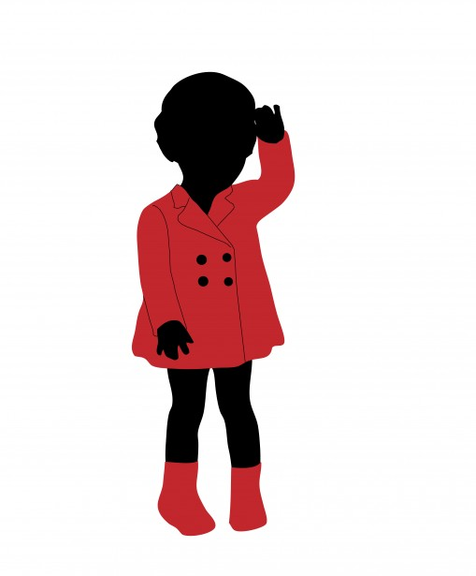
Early Childhood
birth to age 9
Child develops since of self
Language
Social
Emotional
Problem-solving
Motor skills

Slide 4
Social and Economic changes
Changes in families
Changes in employers’ attitudes
Changes in education attitudes

Slide 5
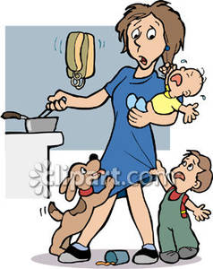
Changes in Families
75% of children have parents working outside of the home or attending school
Women are higher educated
Couples are having fewer children
Many working women are widowed, divorced, single, separated, or spouses do not make enough to support the family.

Slide 6
Changes in Employers’ Attitudes
Employers contribute 1% of the total spent on child care
Companies benefit by positive effects on recruitment, morale, and productivity
Lower turn over and absent rates
Improved quality of the workforce

Slide 7
Changes in Education Attitudes
Most 3,4, and 5 year olds are enrolled in early childhood programs.
More than 33% of children with working parents attend child care centers.
Parents are more aware of their child’s developmental needs.
Children who attend full day kindergarten do better academically and socially during the primary years than those who attend a half day.

Slide 8
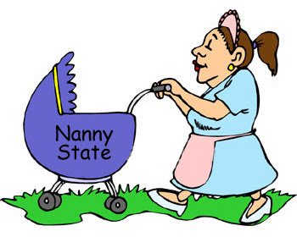
Career Opportunities in Early Childhood
Nannies and Au Pairs
Kindergarten Teachers
Early Childhood Assistant and Associate Teachers
Child Care Teachers and Directors
Family Child Care Home
Licensing Specialist
Other Career Opportunities

Slide 9
Nannies and Au Pairs
A nanny provides care in a child’s home.
Some nannies live in the home.
An au pair is a person form a foreign county who lives with a family and performs tasks similar to a nanny.

Slide 10
Kindergarten Teachers
You need a bachelors degree in education to teach Kindergarten.
Getting your staff certification is a good stepping stone to becoming a teacher.
Can work in a public or private school.

Slide 11
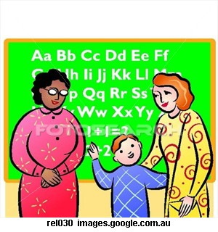
Early Childhood Assistant and Associate Teachers
May be hired to meet ratio requirements
Job is to assist a lead teacher in providing a developmentally appropriate curriculum.
Do not require a degree
May require specialized coursework or training in child development or early childhood education.
Can help you gain the experience needed to advance to a lead teacher position.

Slide 12
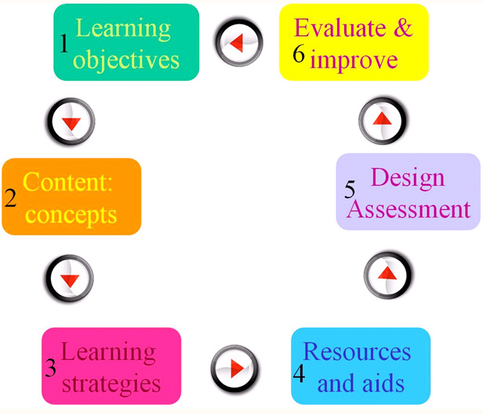
Child Care Teachers and Directors
Teachers is responsible for planning curriculum and teaching children
Director’s responsibilities are broader.
Director is responsible for marketing the program, recruiting children, hiring and supervising staff, and managing the budget.

Slide 13
Family Child Care Home
6 weeks- 12 years old
Allows the provider to work form home.
Many times have longer hours of operation
Providers can also care for their own children.

Slide 14
Licensing Specialists
Usually employed by the state
Protect and promote the health, safety, and welfare of children attending centers.
Make regularly scheduled on-site visits to assigned centers.
Observes whether the center is following state licensing guidelines.

Slide 15
Other Career Opportunities
Parent educator-work with parents to help them learn parenting skills.
Community recreation leaders
Children’s art, dance, music, and sports instructors.
Social workers
Counselors
Therapists
Health care providers
Entrepreneur- creates own business.

