Slide 1
Chapter 2
Types of Early Childhood Programs

Slide 2
Types of Early Childhood Programs.
Family child care
Child care center
Montessori school
Head start
Kindergarten
School-age child care
Parent cooperatives
Laboratory schools
High school child care programs

Slide 3
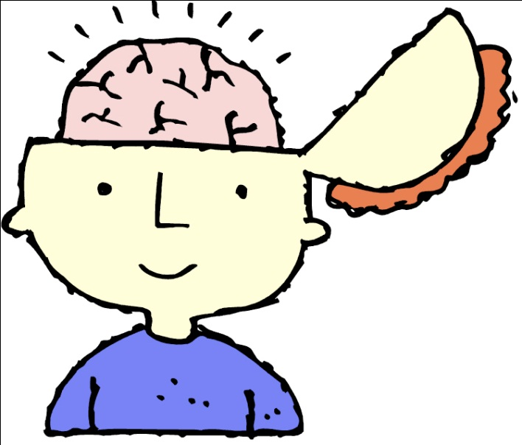
Brain research shows that children learn from the earliest moments of life.
Learning is the most rapid from birth to 5.
A challenging environment can help children develop cognitively, emotionally, socially, and physically

Slide 4
Family Child Care
Most common other than family care
Must be licensed
Some provide mainly custodial care (meeting the child’s physical needs)
Homes where caregiver has early childhood training will provide developmentally appropriate activities.

Slide 5
Child Care Centers
Focus to provide care and an education
Curriculum emphasizes the whole child
Most open early and close around 6:00 or 7:00
State licensing rules influence the program.
The program should meet the needs in all areas of development.

Slide 6
Montessori Schools
Maria Montessori developed her own method of educations. (She lived in Italy and had a degree in medicine)
Children learn best by being active.
First Montessori school was in Rome.

Slide 7
Montessori Schools Approach
Stress proper nutrition, cleanliness, manners, and sensory training.
Children’s senses were trained and they learned to think.
Self-education- “learn how to learn”
Independence is stressed
Teachers provide little help
Academics are stressed but first sensory training must be mastered.

Slide 8
Head Start
Started by the government
Provide child care and education for four and five year olds from low income families
One of the most successful preschool and family support programs in the country
Open year round
build self-esteem, self-confidence, curiosity, and self-discipline.
parent involvement is important
Once they enter school they are more likely to be successful.

Slide 9
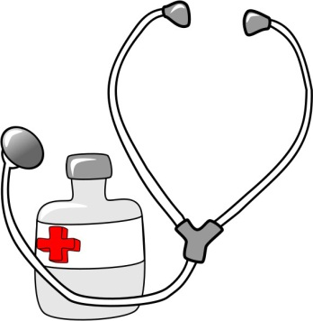
Head Start
Nutrition is a vital part of the program
Goal is to help children make healthy food choices and develop good eating habits.
Dental, medical, and mental health services are provided.

Slide 10
Kindergarten
In 1837 first kindergarten opened in Germany.
Curriculum stressed play
1856 first American kindergarten was opened in Margerenthia Schursz home.
Today they are part of most public schools.
3 scheduling patterns: half-day, full-day, and full-day/alternating day sessions.

Slide 11
School-Age Child Care
Provides care before and/or after school
Do homework, play games, and other activates

Slide 12
Parent Cooperatives
Run by parents who wish to take part in their children’s preschool experience.
There are advantages and disadvantages.
Usually operate for two or three hours for two to five days each week
Fees are low due to parent involvement.

Slide 13
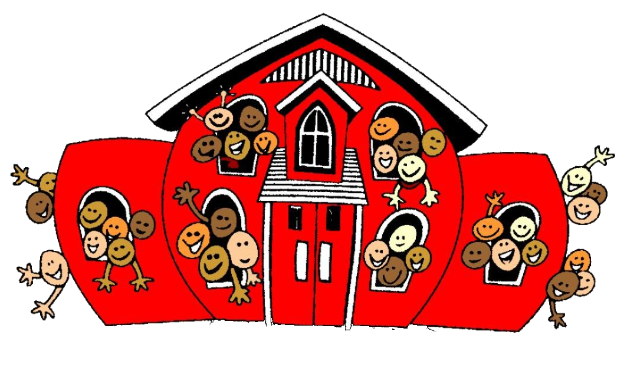
Laboratory School
Primary purpose is to train future teachers
Also called campus schools
Located on college campuses

Slide 14
High School Child Care Programs
Little Squires at OHS
Work with preschool children
Students plan and present the curriculum under teacher supervision.

Slide 15
Sponsorship of Early Childhood Centers
Three types public, private, and employer-sponsored centers

Slide 16
Public Sponsorship
Funded by federal, state, or local governments.
Example- Head Start
Little to no fee

Slide 17
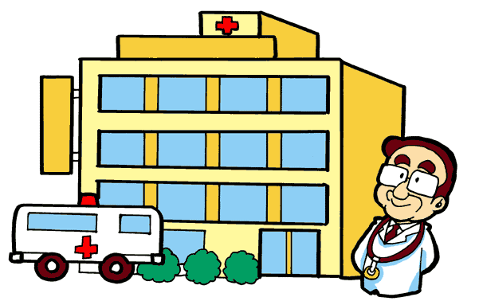
Private Sponsorship
Privately owned centers
Parent pay fees to cover cost
Operated by a church, hospital, charitable organizations, or independent owners.
National child care chains

Slide 18
Employer Sponsorship
Employer may pay part or all of the costs
Reduce the conflict between family and work responsibilities.
See chart 2-7 on page 36
On-site center
Off-site center
Vendor provided centers
Voucher provided by company
Sick child care
Referral services

Slide 19
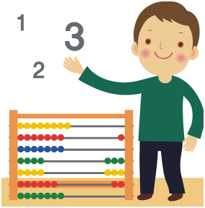
Selecting a child Care Program
Parents want their child to be safe
Promotes all areas of child development
Coast and location
Quality of program
Training and experience of the staff
Staff turnover rates

Slide 20
The Selection Process
Identify options
Call available programs and ask questions
Visit the center
May want to bring their child to see how the child responds

Slide 21
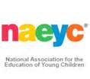
Center Accreditation
Being accredited certifies that a set of standards has been met
The National Academy of Early Childhood Programs administers a voluntary accreditation system.
Public recognition is the main benefit of achieving accreditation status.
Accreditation has improved program quality.

